Slide 1
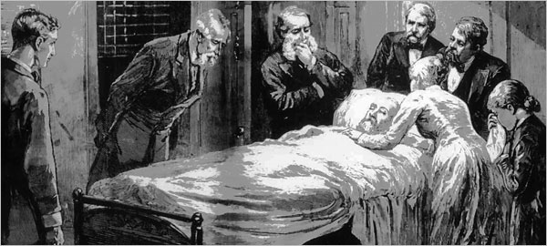


Pedagogical Strategies for Teaching about Alexander Graham Bell’s Metal Detector
Ebone ` B. Pierce
Dr. Sytil Murphy & Dr. Dean Zollman
August 6, 2010

Slide 2
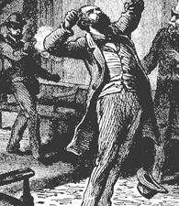
President James Garfield

Slide 3
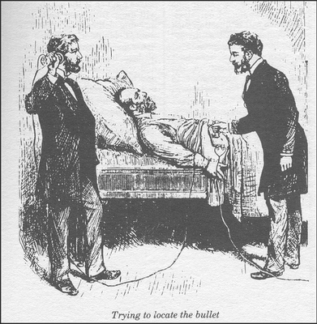
Alexander Bell’s Proposal

Slide 4
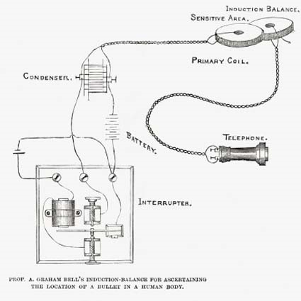
Alexander Bell’s Metal Detector

Slide 5
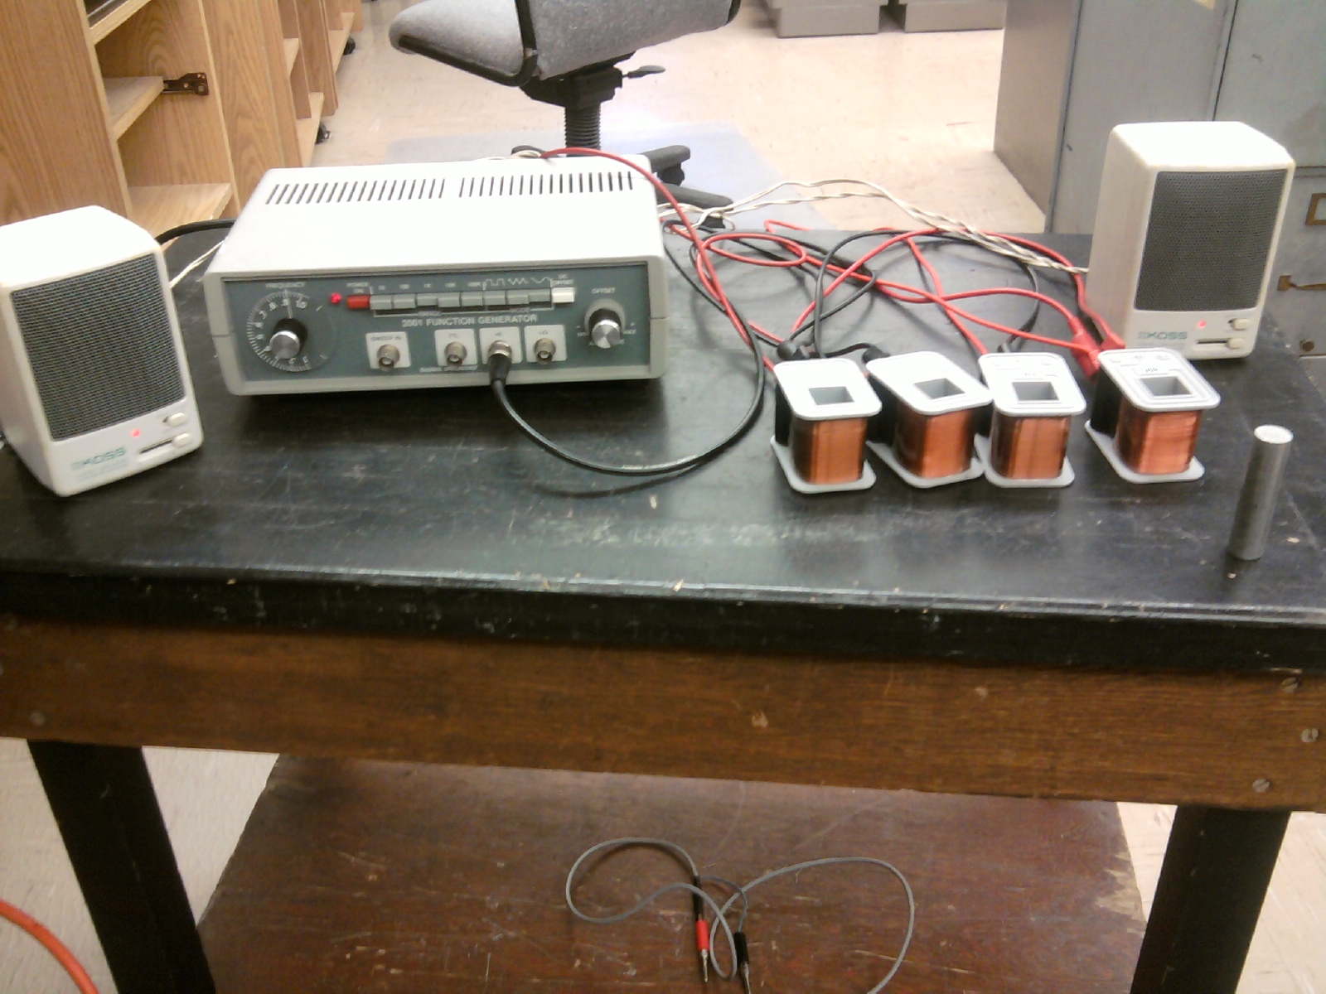
Modern Day Bell’s Experiment

Slide 6
Student’s Learning of Electricity and Magnetism
Difficulties
improvements
Terminology and Definitions in physics courses and textbooks¹
Difficulty for students to change their initial ideas²
Math skills³
Always using a book for aid⁴
Try to be consistent and logical¹
Break students from closed minded assumptions ²
Math/physics professors should work together on students views of different math problems³
Using tutorials and hands on applications⁴

Slide 7
First Draft Lesson Plan
Some Properties of Electric Circuits
  Basic electricity relationships
  Difference between real and simulated circuit
  Build circuits from drawings
  Use multimeter to read circuits
Electricity and Magnetism
  Circuits
  Induction
  E & M Together

Slide 8
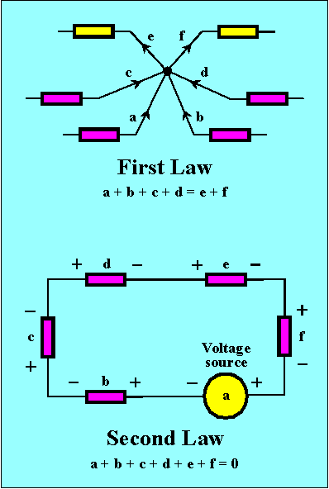
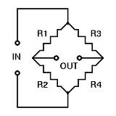
Lesson Continued
Introduction to Kirchhoff’s Laws
Wheatstone Bridge

Slide 9
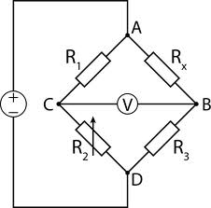

Lesson Continued
Bridge with Inductors
Teddy Bear Experiment
L
L
~
L
L

Slide 10
Future Work
Implement lessons with physics students
Get their feedback from the experiment and modify lesson as necessary
Find or develop other lesson plans and materials to conduct an experiment on electricity and magnetism

Slide 11
REFERENCES
1. Thomas D. Rossing. “Magnetic forces and fields: A note on terminology, definitions, and pedagogy.” American Physics Journal 28, November, 1994: 957-958.
2. David P. Maloney, Thomas L. O’Kuma, Curtis J. Hieggelke, Alan Van Heuvelen. “Surveying students’ conceptual knowledge of electricity and magnetism.” American Physics Journal 26, October, 2000: 12-23.
3. Heidi V. Mauka and Dan Hingley. “Students’ understanding of induced current: Using tutorials in introductory physics to teach electricity and magnetism.” American Physics Journal 16, September, 2005: 1164-1171.
4. Timothy Stelzer, Gary Gladding, Jose P. Mestre, David T. Brookes. “Comparing the efficacy of multimedia modules with traditional textbooks for learning introductory physics content.” American Physics Journal 28, October, 2008: 184-190.
5. Alexander Graham Bell. “An Induction Balance.” American Journal of Science Jan-Jun, 1883 :22-63.

Slide 12
ACKNOWLEDGEMENTS
Kansas State University
Physics Education Research Group
National Science Foundation PHY-0851599
Dr. Sytil Murphy
Dr. Dean Zollman
Dr. Larry Weaver
Dr. Kristan Corwin
Entire Physics Department at KSU

Slide 13

QUESTIONS?

